Slide 1

Presents

Slide 2

Women’s Annual League Meeting
September 16th, 2025

Slide 3

Download Meeting Slides
www.womens.NCBBAbasketball.org
Download Presentation from Headlines

Slide 4
How to ask a question??
Type your name, team affiliation, and question in the “Comments” section below the video.
NCBBA Staff will read your question aloud and the current speaker will answer accordingly.

Slide 5

National Club Basketball Association
850 Ridge Ave
Suite 301
Pittsburgh, PA 15212
Phone 412-321-8440 ext. 100
Fax 412-321-4088
https://womens.ncbbabasketball.org/
Facebook: NCBBA
Twitter: @The_NCBBA
Instagram: NCBBA_

Slide 6
Agenda
  What is CollClubSports?
  Meet the NCBBA-W Staff
  2024-2025 - Recap
  2025-2026 – What’s to Come
  Team Operations
  Timetable
  Sponsors & Fundraising
  Voting Ballot Procedures
  Reminders
  Closing

Slide 7
What is CollClubSports?
National Federation of Collegiate Club Sports Leagues, L.L.C.
  National Club Baseball Association (NCBA DI, DII, & DIII)
    Founded 2000 – 34 teams – grown to 290 teams
  National Club Softball Association (NCSA)
    Founded 2006 – 33 teams – grown to 150 teams
  National Club Football Association (NCFA)
    Founded 2009 – 16 teams – grown to 16 teams
  National Club Basketball Association-Men’s (NCBBA-M)
    Founded 2013 – 28 teams – grown to 156 teams
  National Club Basketball Association-Women’s (NCBBA-W)
    Founded 2019 – 52 – grown to teams 93

Slide 8
Mission
The National Federation of Collegiate Club Sports Leagues, L.L.C. (CollClubSports) is a compilation of governing bodies which oversee collegiate club athletics.
We are driven to provide collegiate student-athletes with the opportunity to participate in competitive, organized collegiate club athletic leagues, and to continually enhance this experience for all participants.
We strive to accomplish this by building lasting relationships based upon trust, commitment, dedication, understanding, and strong lines of communication.

Slide 9
Meet the NCBBA Staff
Front Office
President – Sandy Sanderson
Vice President of Basketball Operations – Matt Hazi
Treasurer – Sandy Sanderson Sr.
Accounting Specialist – Jacob Kortenber
Rawlings Sponsor Acct. Manager – Amanda Lam
Travel/Fundraising Sponsor Acct. Mgr. – Eric Curitore
The Game Sponsor Acct. Manager – Felicia Battaglia
Tytan Athletics Sponsor Acct. Manager – Eric Curitore

Slide 10
Meet the NCBBA Staff
Regional Directors
New England Regional Director – Walter Haupt
North Atlantic Regional Director – Robert Montgomery
Mid-Atlantic Regional Director – Harrison Gillenwater
Mid-America Regional Director – TBD
Great Lakes Regional Director – Mia Naman
Pacific Regional Director – Ben Ghilarducci

Slide 11
Download Meeting Slides
www.womens.NCBBAbasketball.org
Download Presentation from Headlines

Slide 12
How to ask a question??
Type your name, team affiliation, and question in the “Comments” section below the video.
NCBBA Staff will read your question aloud and the current speaker will answer accordingly.

Slide 13
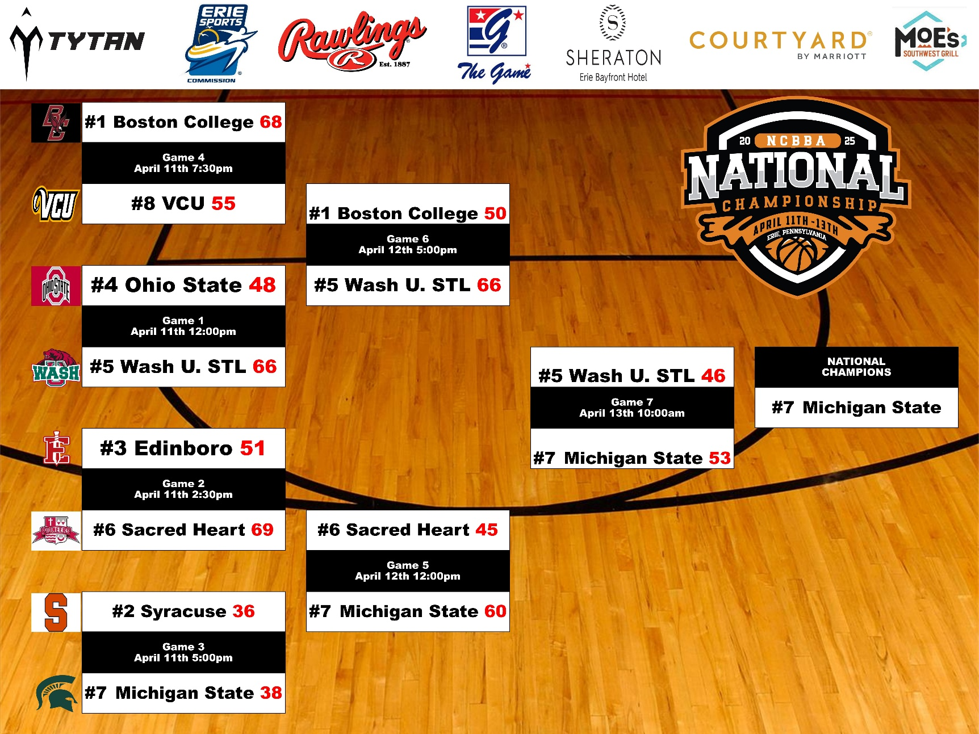
2024-2025 National Championship Bracket

Slide 14
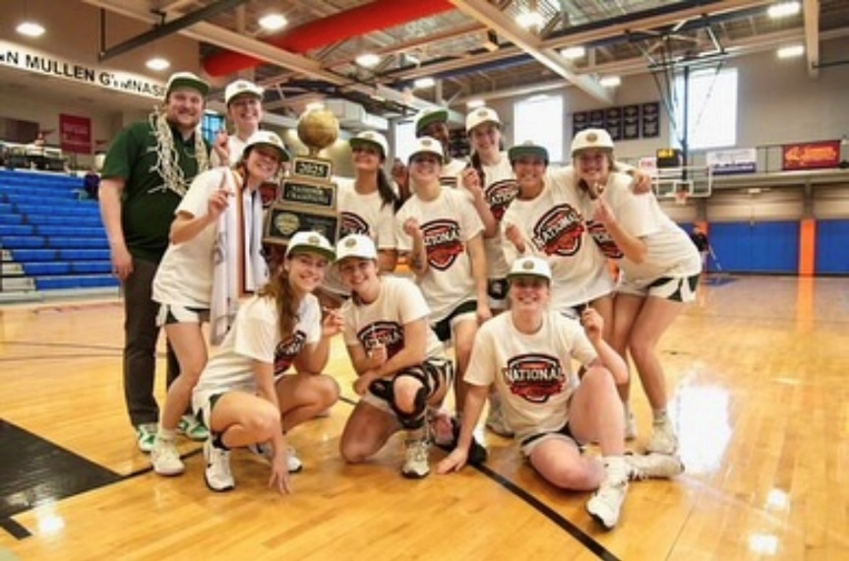
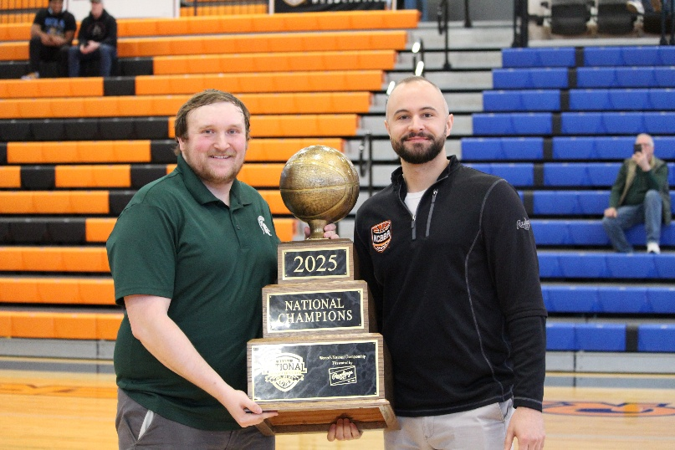
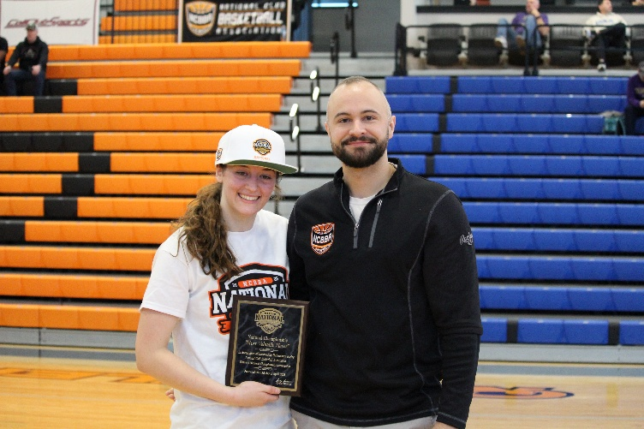
Michigan State 2024-2025 CHAMPIONS!

Slide 15
2025-26: What’s to Come
New Teams
Fall Tournaments
Tytan Athletics Top 15
Conference Realignment
Conference Scheduling
Regular Season
Regional Championships
National Championship
Team Operations for a successful season

Slide 16
New Teams
ALREADY UNDER CONTRACT
  Quinnipiac University
  Thomas College
  University of Richmond
  Cal State Fullerton
EXPRESSED INTEREST FOR 2025-2026
West Chester
UCLA
University of New England
UC Davis
Texas A&M
Cal Poly - Pomona
UC Santa Barbara
Loyola Marymount
Mississippi State
Sacramento State
UNC Greensboro
Ole Miss
TCU
LSU

Slide 17
NCBBA-W GROWTH

Slide 18
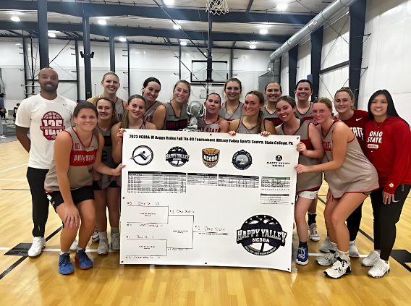
Fall Tip-Off Tournaments
Fall Tournaments for fall 2025+
  Looking to host in North Atlantic, Great Lakes, and Mid America
  Benefits: All teams guaranteed at least 3 games, count as official non-conference games, price is all-inclusive

Slide 19
Tytan Athletics Top 15 Poll
Prior to the season the NCBBA-W assembled a Top 15 Voting Panel comprised of volunteers from across the NCBBA-W and NCBBA Staff members.
During the season, scores were submitted each Monday and the NCBBA website was updated with results every Tuesday.
Every other week, the voting panel submitted a new Top 15 Poll voting ballot.
Poll Results used to determine who hosts regional playoffs, and 25% of the National Championship Tournament seeding formula
LOOKING FOR QUALIFIED, UNBIASED, OBJECTIVE VOLUNTEERS TO SIT ON VOTING PANEL

Slide 20
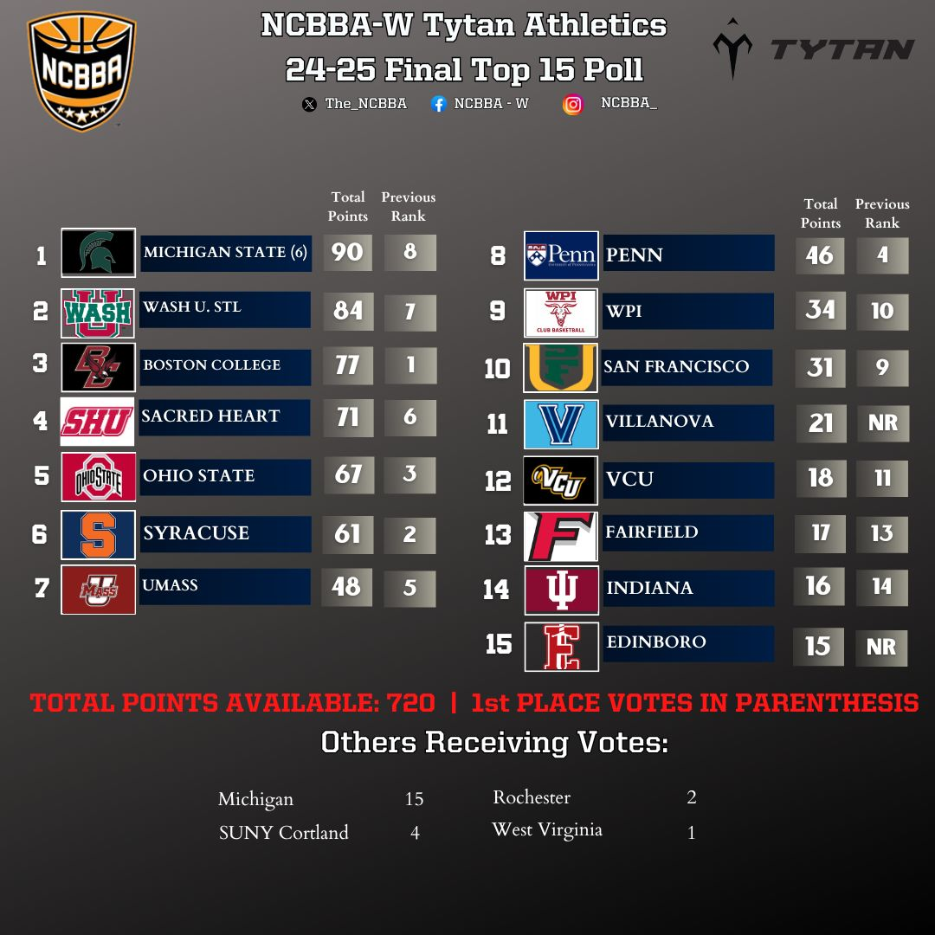
Tytan Athletics Top 15 Poll

Slide 21
Conference Realignment
Once NCBBA-W Completes enrollment of new teams (August), conferences will be realigned as needed to arrange teams geographically to minimize travel
  NCBBA-W hopes to have membership numbers exceed that of 24-25 (93).
  NCBBA-W hopes to create a Gulf Coast Region
  NCBBA-W hopes to expand in Southern California/South Atlantic

Slide 22

Conference Scheduling
Schedule Request Form
  Due approximately Sept 15th – please adhere to deadlines
  Be accurate, be thorough, be flexible
  We are looking for availability first, then preferences
  See Sample Form on next slide
Goal is to have conference schedules released by Oct. 1st
After Conference Schedules are released, teams are encouraged to start scheduling non-conference games

Slide 23
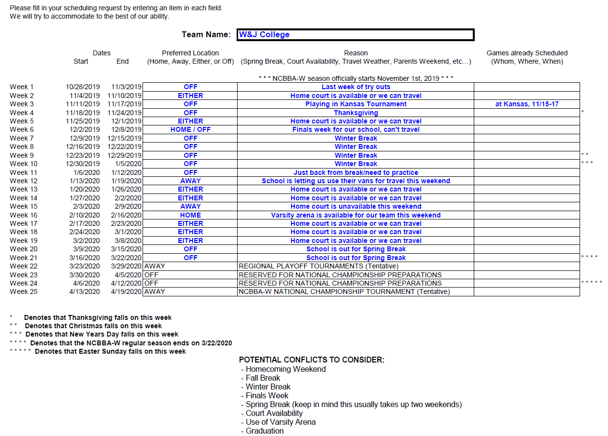
Sample Schedule Request Form

Slide 24
Regular Season
Regular Season will run from November 1st, 2025 – March 22nd, 2026
Each team will be scheduled to play each conference opponent once in a 2- game series
Each team can supplement their schedule with non-conference games at their discretion
Non-conference schedules must be submitted to NCBBA admin in order to put on schedule and for teams to get credit
Non-conference games can be against any COLLEGIATE basketball team (NCBBA, NAIA, NCAA, JUCO, etc…)

Slide 25
Regular Season
Every Monday night, NCBBA will request teams to complete a Weekly Team Submission form and email it to their conference coordinator reporting their scores, results, and Player of the Week nominations from the previous week
  NEEDS IMPROVEMENT! Quicker reporting of scores, and more Player of the Week nominations!
  NEEDS IMPROVEMENT! Keeping full and accurate stats during games and posting stats to website!
Every Tuesday, Conference Coordinators will update scores/results on the NCBBA website and select Conference Players of the Week
Every Wednesday, NCBBA will select National Players of the Week.

Slide 26
2026 Regional Tournaments
As the league continues to grow, eventually the entire league will be comprised of 8 Regions with multiple directional conferences funneling into Regional Championships.
Winners of the Regional Championship Tournaments will automatically move on to the National Championship Tournament.
Ultimate Goal:
  8 Regions, 3-4 Conferences per Region, 7 teams per Conference
Regional Championship Tournaments are held in a single elimination format.
Held 2-3 weeks before the National Championship.
Hosted at the highest ranking conference champion in the Region.

Slide 27
2026 Regional Tournaments
Regional Tournaments planned for March 28th-March 29th, 2026
Regional Tournaments will be hosted at highest seeded team’s home court

Slide 28
2026 National Championship
April 10-12, 2026 (Easter is April 5th)
8-Team single elimination tournament
  Regional Champions and at-large selection(s) (if applicable) make up the field of teams
  National Championship also includes Skills Competition
Beginning in June, NCBBA-W will begin the search for our National Championship Venue and host city.
Goal is to secure a venue that meets the needs/expectations of the member teams.
Encourage teams to offer suggestions especially if their on campus venue is available.
Return to Erie, PA is an option

Slide 29
2026 National Championship
Search for a venue will be based on these priorities unless otherwise directed:
  1st – Court Surface (Hardwood)
  2nd – Tournament Venue (Small Collegiate Arena)
  3rd – Tournament Location (Centrally Located)
  4th – Auxiliary Practice Facilities
  5th – Venue to have onsite locker rooms
  6th – Separate from Men’s National Championship

Slide 30
2026 National Championship
Improvement Goals:
  Get more non-championship teams to participate in skills competition
  Further develop relationships with local business to come on as local event sponsors.
  Create an advertising budget in order to further promote the event in hopes of boosting local attendance.
    We want our players to compete in front of a crowd.
  Have larger presence on social media.
    Entice non-qualifying teams to get there and non-member teams to join!

Slide 31
Download Meeting Slides
www.womens.NCBBAbasketball.org
Download Presentation from Headlines

Slide 32
How to ask a question??
Type your name, team affiliation, and question in the “Comments” section below the video.
NCBBA Staff will read your question aloud and the current speaker will answer accordingly.

Slide 33
Team Operations
Being informed, organized and having strong lines of communications is key to a successful season.
League Participation Agreement (LPA)
  New Team Form (Due Date: August 1st)
  Existing Team Renewal Form (Due Date: June 1st)
  Signed by president of team, signed by club sports director or faculty advisor
  Fax or scan and email to NCBBA
Registration Form
  Provides full contact info to NCBBA front office
  Complete in full and email to NCBBA
  Important to include a secondary contact, team email and head coach if applicable
  Important to include advisor contact info

Slide 34
Team Operations
Being informed, organized and having strong lines of communications is key to a successful season.
Scheduling Request Form
  Due September 15th and used to complete Conference Schedule
  Important to complete with as much detail as possible
  Important to include requests for Christmas Break, Spring Break, Finals, and Court availability
  The more flexibility the better
General Liability Insurance
  $2,000,000 General Aggregate, $1,000,000 Per Occurrence
  Policy covers the NCBBA and it’s members (The Teams)
  Covers many aspects of NCBBA play (i.e. Travel, Practice, Workouts, Games)
  Full Year of Coverage
  Policy assists in obtaining court time & 3rd parties can be additionally insured for $75
  This policy helped protect the NCBBA and it’s members from potential financial losses from lawsuits, but, this is NOT a health or accident insurance policy

Slide 35
Team Operations
Being informed, organized and having strong lines of communications is key to a successful season.
Reserving Court Space
  DON’T PROCRASTINATE
  Contact opponents once schedule is released to set dates and times
    If opponents won’t communicate let NCBBA know and we can help facilitate
  Don’t wait till a week before you are to play
  Reserve court as soon as schedule is released
  3rd party additional insured
Scheduling Referees
  Contact local high school AD to gain contact info for local referee assignor
  2 High school certified (or better) referees per game
  Don’t wait until a week before you are to play
  Contact assignor as soon as schedule is released and re-confirm dates and times
    If you do not have an assignor let NCBBA know and we can help facilitate finding one

Slide 36
Team Operations
Being informed, organized and having strong lines of communications is key to a successful season.
Team Manager Access & Online Player Registration
  At the beginning of each year, the “Team Manager” will need to request Team Manager access from the NCBBA.
  NCBBA will give individual Team Manager Access which will allow the Team Manager to access the Team Code, view the Registration Queue and have other access that players do not have (updating Team Information).
  Players will receive a TEAM CODE for their team to begin the player registration
  Individual Players register by either choosing “Existing User/Returning Login” or “First Time Player Registration” in the “Login” tab of the NCBBA sites.
  Players fill out information which determines eligibility
  Once online registration is completed, players will be put in a “Registration Queue”
  Players able to log back in to upload a picture, bio and change certain information such as jersey number and position.

Slide 37
Team Operations
Being informed, organized and having strong lines of communications is key to a successful season.
Coaches Participation Waivers
  For non-playing coaches, managers, trainers, etc.
  MUST be typed, printed, SIGNED, then faxed or scan and emailed
  Coaches, managers, trainers, are NOT allowed on the court or on the bench unless they have a waiver on file with the NCBBA
  Found under “Info => Documents” tab of NCBBA websites (along with many other important documents to reference/utilize)

Slide 38
Team Operations
Being informed, organized and having strong lines of communications is key to a successful season.
Academic Eligibility Letter
  Sample format available under “Info” tab of NCBBA websites
  Must be signed by registrar, faculty advisor, or club sports director
  Can be faxed or scanned and emailed to NCBBA Front Office
  Must show currently enrolled, 12+ credits (9+ for 2 year schools), 2.0+ GPA, no academic warning, and no academic probation
  Players listed on AEL and listed in the Registration Queue, will be added to official NCBBA roster
Uploading player stats and team information
  Once players are cleared by the NCBBA as eligible and appear on the website roster, Team Managers may upload stats for those players
  Team Managers can login with their credentials (email & password) and will have ability to upload stats and other team information.
  Instructions on how to upload the stats and other team information will be sent once Login and Password are requested, but are also listed under the “Info” tab of NCBBA websites
  Teams are responsible for uploading their own stats
  It is the responsibility of the team to be sure that stats are entered accurately and in a timely fashion

Slide 39
Team Operations
Being informed, organized and having strong lines of communications is key to a successful season.
Weekly Team Submission Form
  Submit to Regional Director by midnight each Monday
  Be sure to enter scores/results for ALL games played during that week
  Be sure to submit a full stat line when nominating players of the week candidates
  Submit these on time to assure that your candidates receive consideration for awards
NCBBA Dues
  Includes 3 NCBBA Official Basketballs and $2 Million general liability insurance
  Teams will submit a refundable $150 performance bond due by October 15th. If your team did not forfeit any conference games, performance bond rolled over to current year.
  $950 due in full by February 28th
  $100 discount if paid in full by December 31st
  Credit Cards accepted but subject to online handling fee
  Invoices and receipts available through the NCBBA Accounting Specialist, Jacob Kortenber (Jacob.Kortenber@CollClubSports.com)
  EIN/Tax ID#: 52-2270910

Slide 40
Team Operations
Being informed, organized and having strong lines of communications is key to a successful season.
Boosting team interest
  Student involvement fair for incoming freshmen
  Advertisement/Coverage in school paper
  Flyers in freshmen dorms and common areas
  Create a social media groups/pages/accounts
  Make presence known on campus
Boosting Team Morale
  Get the team together off the court as much as on
  Social events where ALL are included can build strong bonds => leads to more success on the court
  Road trips build strong team chemistry
  Set room assignments on the road to break up “Clicks”
  Being organized will give opponents the impression of strong leadership while instilling pride in your team to compete with confidence
    Arriving in uniform, team vans, choreographed warm ups, show opponents that you take things seriously
    Choreographed practices with a set practice attire sends that same message to your players

Slide 41
Team Operations
Being informed, organized and having strong lines of communications is key to a successful season.
Budgeting
  Very important to set accurate budget
  Make sure to include Expenses such as referees, courts costs, uniforms, equipment, travel expenses, league dues etc.
  Income items such as player dues, fundraisers, donations, school input, etc.
  BUDGET FOR POST-SEASON TOURNAMENTS EVERY YEAR!
Player Dues
  How much to charge?
  What is included?
    Travel costs? New Uniforms?
    More included = Higher Dues$
  Supply & Demand: Lots of interest = Higher Dues$
  Make them pay as soon as they make the team
    Players who practice for months then fail to pay dues hurt the team financially and chemistry
  Charge $5 for tryouts

Slide 42
Team Operations
Being informed, organized and having strong lines of communications is key to a successful season.
Team Equipment/Uniforms
  Order early as customized items tend to have extended lead times
  Order extra shorts and jerseys; uniforms do rip or go missing on occasion
  Order extra game basketballs when the supply runs low, NCBBA rules state you must use the Official NCBBA Basketball.
  Get quotes from NCBBA sponsors, there is a reason why the NCBBA endorses them
  Take advantage of additional NCBBA discounts during early ordering periods
  See list of NCBBA Sponsors and discounts provided on NCBBA website

Slide 43
Team Operations
Being informed, organized and having strong lines of communications is key to a successful season.
Guide To Collegiate Club Basketball
Developed by NCBBA in order to:
  Define and publicize the concepts and goals of the NCBBA
  Assist with the development and recruitment of new basketball teams
  Provide an all-inclusive reference manual to NCBBA league operations
  Assist with the improvement of member team basketball operations
Chapter Titles:
  What is the NCBBA
  Starting a team at your school
  Joining the NCBBA
  Operating w/in the NCBBA (Preseason, In-season, Post Season)
  Making your team better
  Fundraising and Sponsors
  Chapters can be downloaded on the “Documents” tab of NCBBA website

Slide 44
Timetable
June 1 Renewal LPA deadline
September 16 Annual League Meeting
September 15 Schedule Requests due
September 23 Rules Ballot due
October 1 Conference Schedules released
October 15 Team Previews Due/Performance Bond Due
October 30 Preseason Polls Released
November 1 Regular Season begins**
December 31 Deadline to receive Annual League Dues discount
February 28 Deadline for payment of Annual League Dues
March 22 Regular Season conclusion
March 28-29 Regional Championship Tournaments
April 10-12 NCBBA-W National Championship Tournament
*Estimated Date
** Player Registration & Academic Eligibility Letters
due 2 weeks before first game.

Slide 45





Sponsors & Fundraising

Slide 46

Eric Curitore -
Fundraising Sponsor
Account Manager
Eric.Curitore@CollClubSports.com
412-910-4542

Slide 47

FUNDRAZR
FUNDRAZR is an Official Fundraiser of the NCBBA
  Online fundraising platform for any budgetary need
  Start a campaign online completely free of charge
  Share on Facebook, Twitter, team websites and via e-mail to reach more potential donors

Slide 48
FUNDRAZR
  Invite players to share the fundraiser and make it a friendly competition within the team
  All you need are an e-mail address and a Verified PayPal Account to get started
  Florida Club Football created sub campaigns for each individual player
  Each players campaign was tied to the Master campaign to tally up all donations as a group
  Contact Eric.Curitore@CollClubSports.com for how you can start a campaign

Slide 49
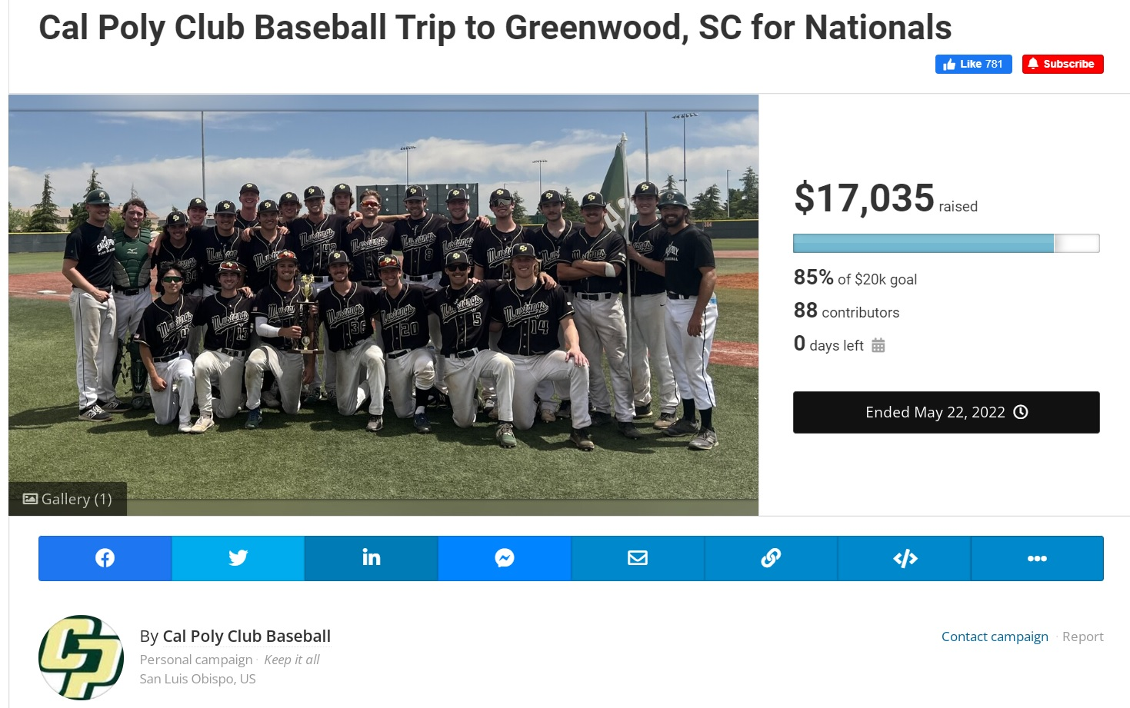

Slide 50
Eric Curitore
Travel Sponsor
Account Manager
Eric.Curitore@CollClubSports.com
412-910-4542

Slide 51

The Official Lodging Partner of the NCBBA
  Teams, players, and fans receive a minimum of 10% discount on Best Available Rate (Personal or NCBBA Related)
  Book online using the NCBBA & CollClubSports Booking Portal motel6.com/en/cp/coll-club-sports.html
  Speak to a Motel 6 Representative and make your reservation over the phone by calling 1-800-899-9841 and mention the CollClubSports Corporate ID Number “CPUM4EHL”
  Contact Eric.Curitore@CollClubSports.com for more info or if you have any questions!

Slide 52
Felicia Battaglia
The Game Sponsor
Account Manager
Felicia.Battaglia@CollClubSports.com
412-910-4538

Slide 53

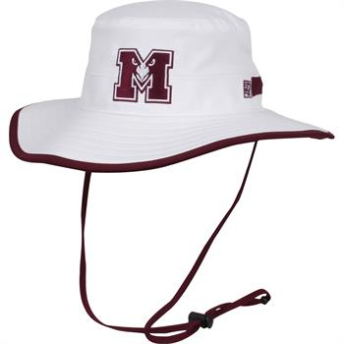
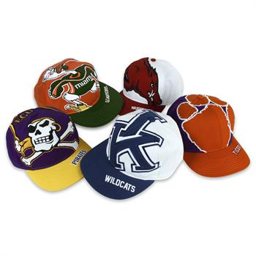
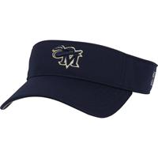
Official Headwear Sponsor of the NCBBA
Some Great Product Offerings:
- Beanies, Boonies, and Visors
  Pick your style, colors, and logo!
  Customizable Caps
Fundraisers
www.THEGAMEHEADWEAR.com

Slide 54
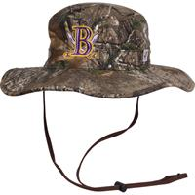
Exclusive low prices & customizations!
Early Order Discounts
Free NCBBA shield included
- Contact – Felicia Battaglia
        Felicia.Battaglia@CollClubSports.com
        412-910-4538

Slide 55

Amanda Lam
Rawlings Sponsor Account Manager
Amanda.Lam@CollClubSports.com
412-321-8440 x 111

Slide 56
The Official Basketball of the NCBBA
  Each NCBBA member team will receive 3 Official NCBBA Rawlings basketballs FREE of charge.
  Each basketball will have the official NCBBA artwork.
  ONLY RAWLINGS basketballs are legal for Conference Games.

Slide 57
    Teams will receive equipment forms via email prior to the season to go about receiving their basketballs.
      Institution Name
      Name on Order
      Address
      City, State, Zip code
    Recommendation: use an ON-CAMPUS ADDRESS for basketballs shipment

Slide 58

Eric Curitore
Tytan Athletics
Sponsor Account Manager
Eric.Curitore@CollClubSports.com
412-321-8440 x 101

Slide 59

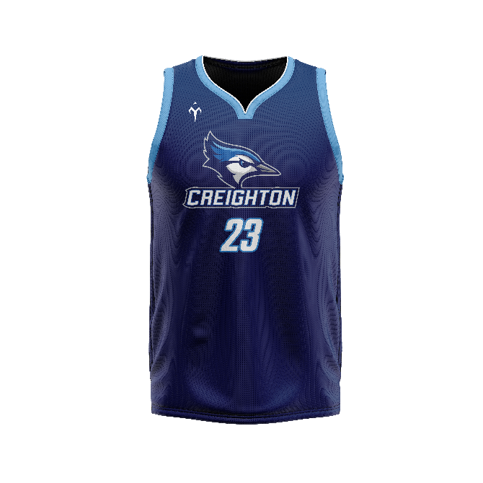
Official Uniform Provider of the NCBBA
Tytan Athletics offers exclusive prices on all stock & custom Uniforms EXCLUSIVELY to NCBBA teams!
  Fully customizable options
  4-5 Week Turn Around
  Each & every jersey & short garment will feature the NCBBA logo – FREE of charge
  Discounts Available!

Slide 60

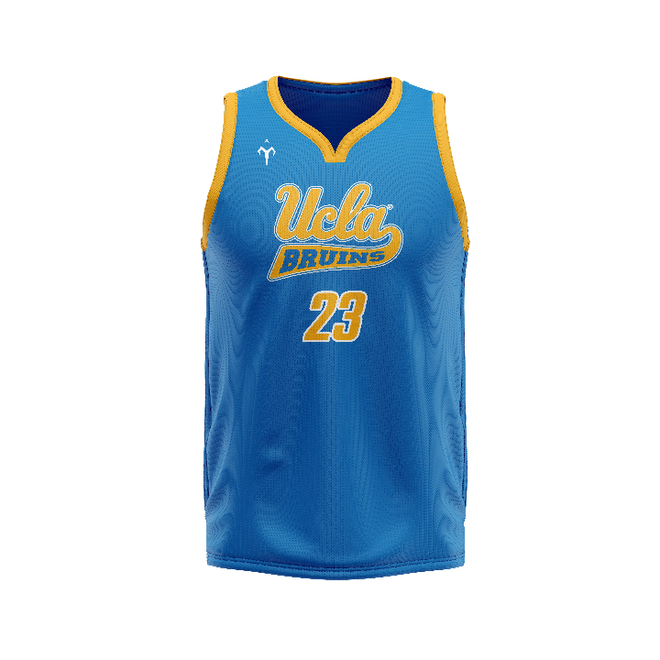
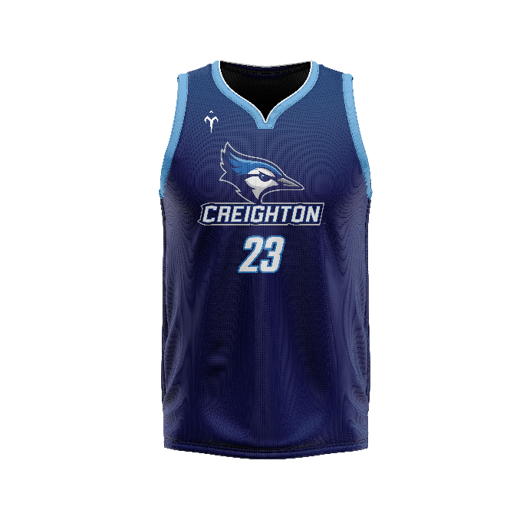
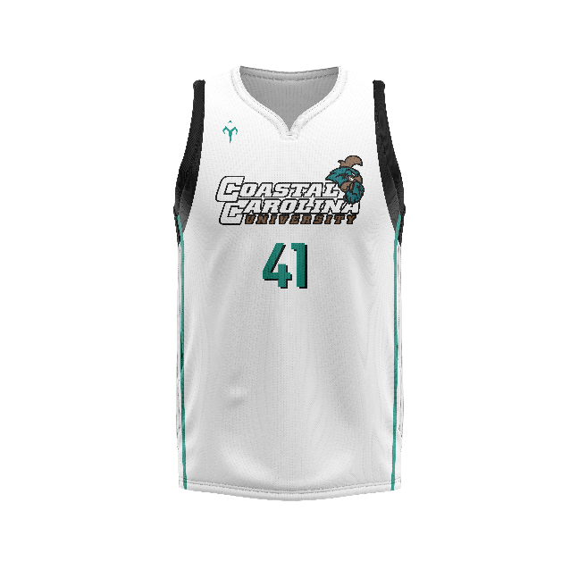
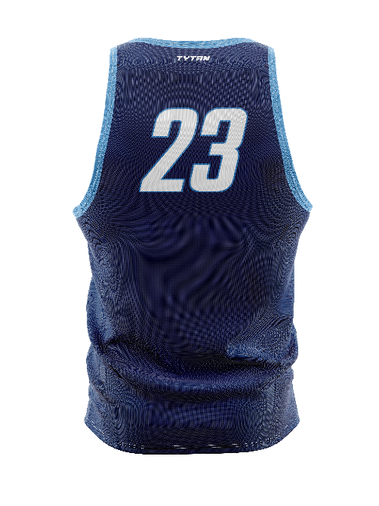
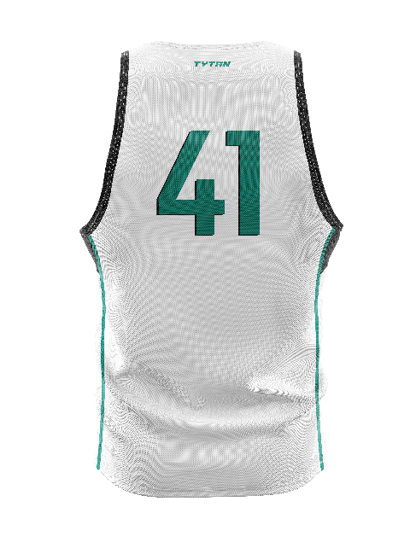
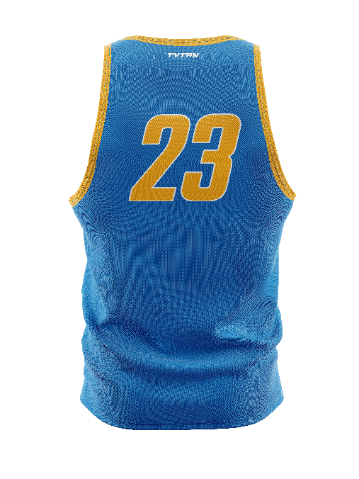
Tytan Athletics
Contact Tytan Athletics directly at Tytan@TytanAthletics.com!

Slide 61
Voting Ballot Procedures
Issues addressed one at a time
Open forum to create the ballot
Ballots will be emailed out in 1 Week
Each team gets to submit 1 Voting Ballot
Voting Results Released in Approx 2 Weeks

Slide 62
Proposed Rules
The floor is open for any team rule proposals
Please submit your rule proposal one at a time by entering it into the comment section

Slide 63
Reminders
Game Clock
  NCBBA-W sanctioned basketball games are played with 4 10 minute STOPPED CLOCK quarters.
Team Timeouts
  Each team gets 6 timeouts – 4 full and 2 30’s.
Officials
  Per NCBBA rules, officials must be AT LEAST high school certified.
Uniforms
  All Uniform Jerseys must match both in color and style including decorations and trim.
  Teams are starting to look sloppy with players having mismatched uniform jerseys.
  This is NOT IM basketball… let’s not make it look like it!
  Uniform Shorts only need to match in base color
  Teams should realize their players that are not technically in uniform risk ejection from the game (with warning).

Slide 64
Reminders
Needs Improvement
  Weekly Team Submissions turned in on time with player of the week nominations.
  Adding statistics to website
  Participation in All-American Nominations
  Less forfeitures! Organization is key. Let NCBBA help.
We Need Your Alumni!
    The NCBBA-W is looking for club basketball Alumni who want to volunteer to stay involved with the NCBBA-W as we grow.
    We are looking for:
    Regional Directors (Paid)
    Top 15 Voters
    Tournament Staff
    Great opportunity to stay involved, gain experience, or build a resume
    No out of pocket expenses, just want your passion to help the sport grow

Slide 65
Closing
Thank You for Tuning in
Promote the League & Website
Give the Sponsors Business whenever possible
Whenever Issues Arise, Please Notify Us
Let No Question Go Unanswered
Keep Lines of Communication Open
Please be Prompt Meeting Deadlines
It’s a Game!! Have Fun!!

